Slide 1
CODE WITH GLOBALSHALA 2.0
PROTOTYPE PRESENTATION

Slide 2
TEAM : DARTH VADER
MEMBERS : ANKIT KUMAR(1805279@kiit.ac.in)
DIVYANSH SINGH(singh.divyansh1802@gmail.com)
ASHISH PRASAD(prasad.ashish162@gmail.com)
THEME : DIGITAL BADGING

Slide 3
PROBLEM STATEMENT
The main aim of the theme is to create a digital badging system to motivate , encourage the learners by awarding them the badges in different fields like technology , social services , behaviour etc . Also educators or recruiters can also use it to see the progress of the person or students . Students or learners can also know the which tech-stack or domain is in the trend or widely used in the market .

Slide 4
OBJECTIVES OF THE PROJECT
The prime objective of the DIGITAL BADGING platform is to provide a unified platform to the learners and educators/recruiters .
It motivates the learners to learn , enhance and recognize their skills . Learners can recognize their skills by earning the badges for the corresponding skills .
Educators or recruiter can use it to visualize the learners progress and and his/her expertise.
Recruiter can also shortlist students based on their skill-set .

Slide 5
TECHNOLOGY PLATFORM
Frontend : HTML , CSS , Javascript
Framework : Bootstrap
Library : JQuery
Backend : PHP
PHP is used in backend because of its simplicity and large scale usability, efficient performance
Database : MySQL
Mysql is most widely used relational database because of its security and high performance

Slide 6
SCALABILITY : This platform can be further extended for a university in recruiting students. EFFECTIVENESS : This platform can be easily implemented for personal as well as for commercial use . it will motivate learner to constantly improve their skill set according to the market demand and also it will create a healthy competition among the learner . recruiter can directly communicate with the learner in particular domain he/she is recruiting for. ASSUMPTIONS : All skills /certificates mentioned by students are true to his best knowledge as there is no automation to verify the certificates .

Slide 7
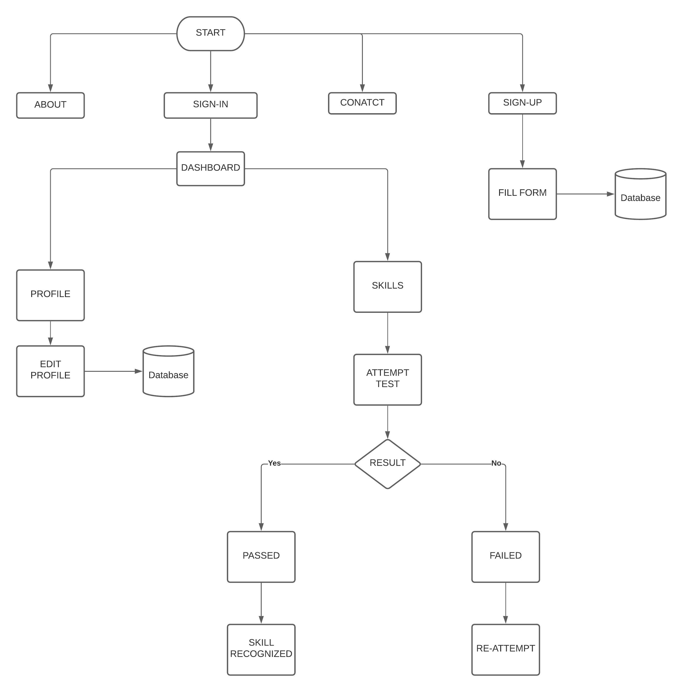
FLOW CHART

Slide 8
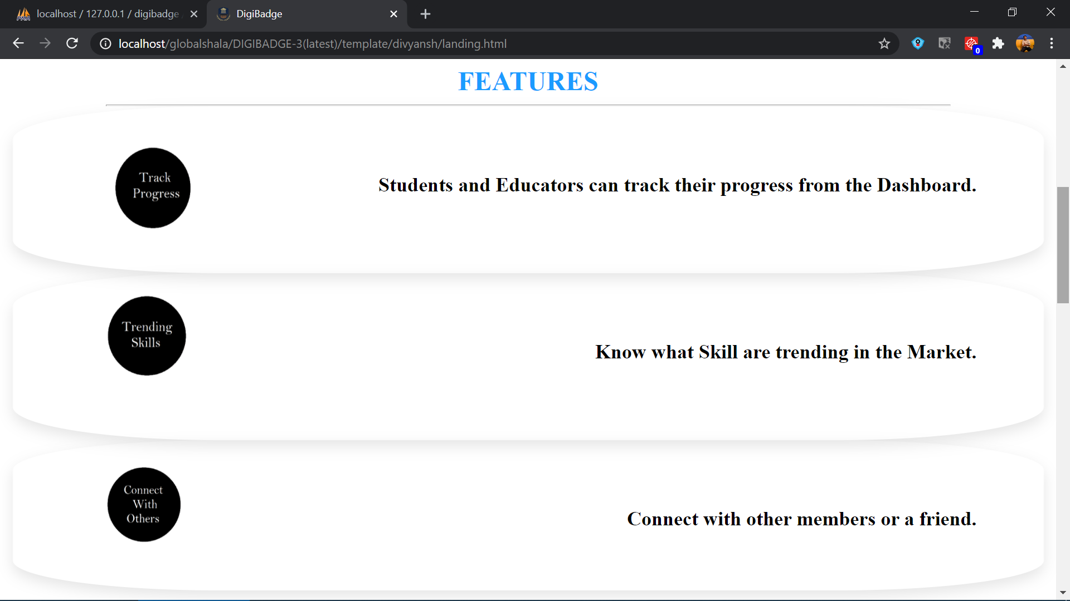
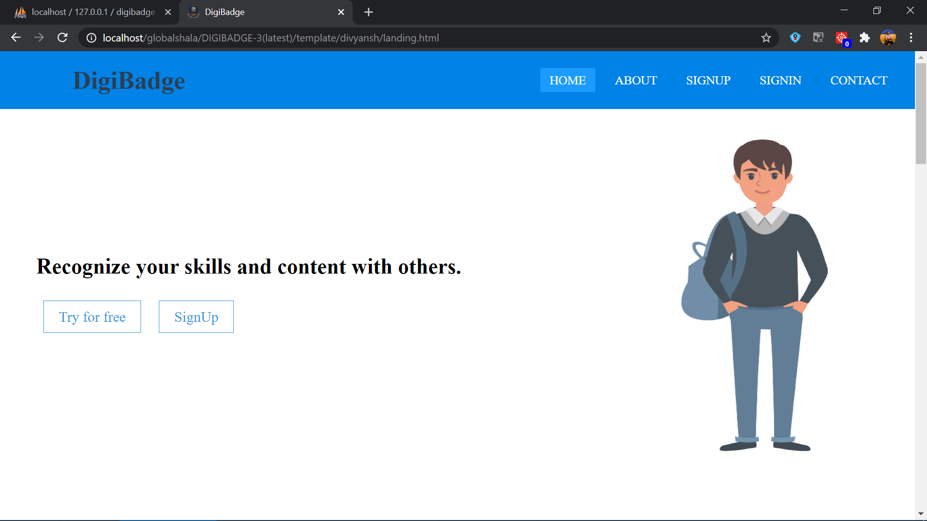
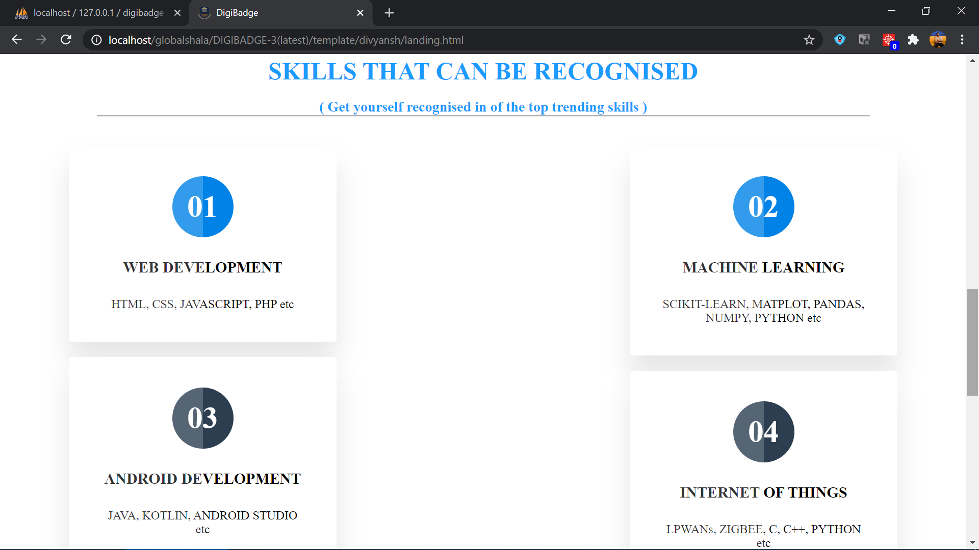
PROTOTYPE SCREENSHOTS

Slide 9
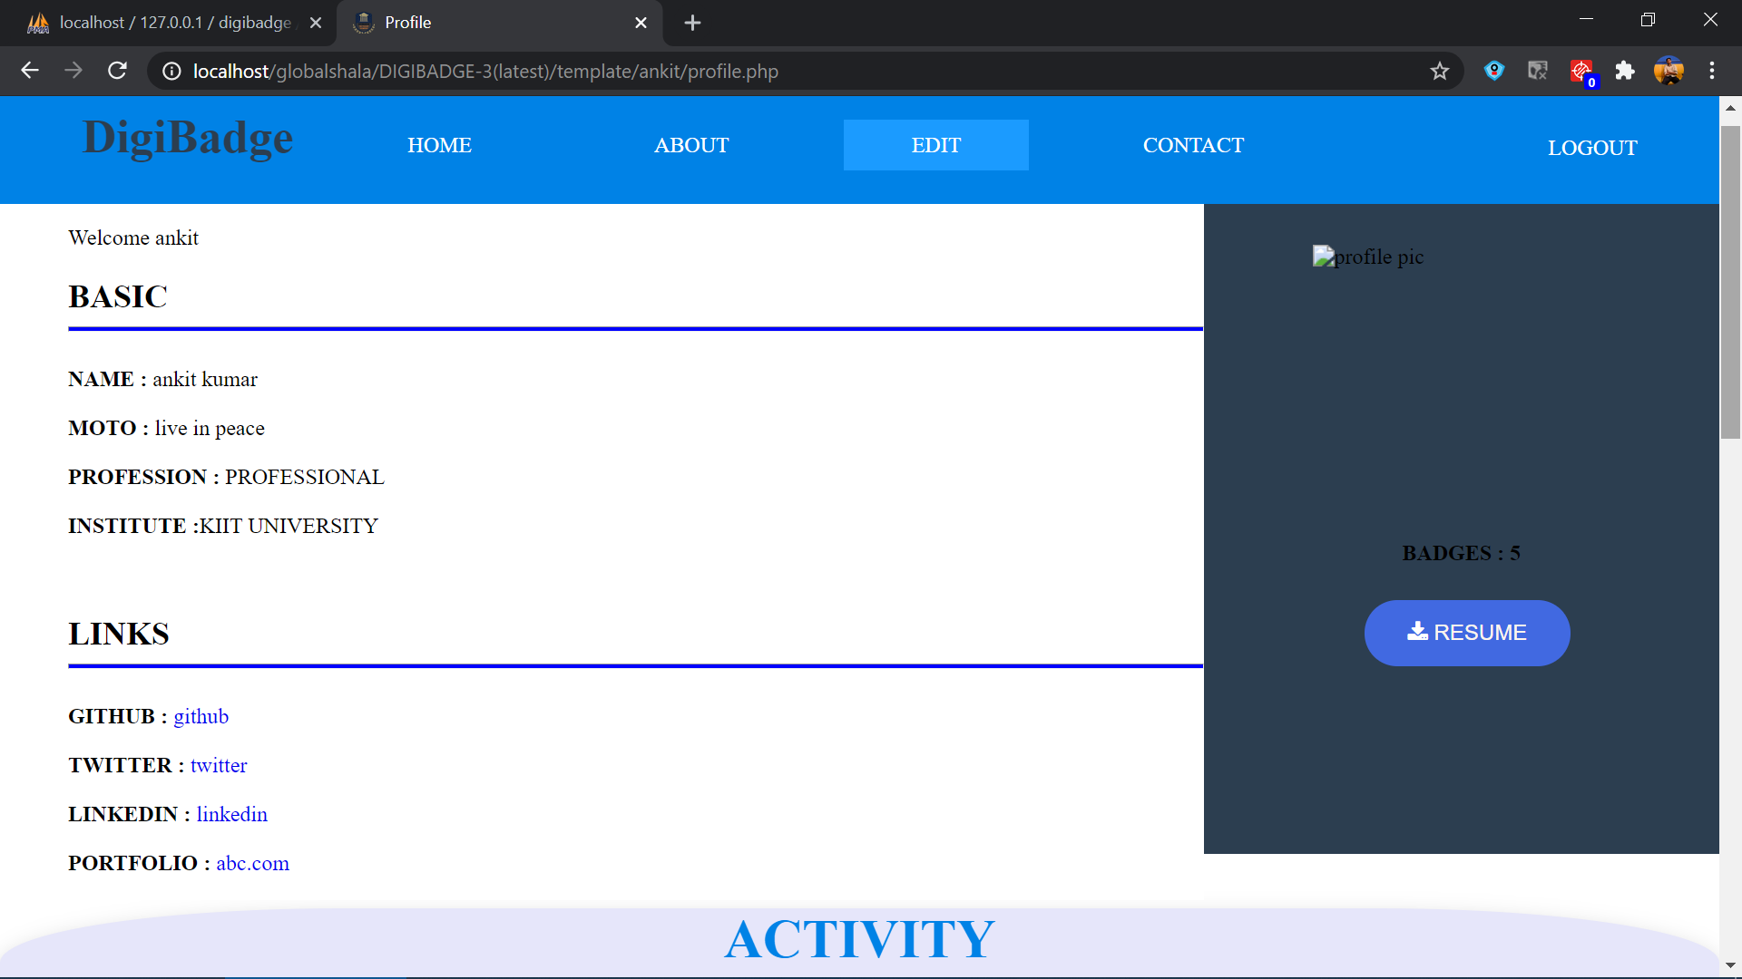
PROFILE PAGE
The first scrolling page of Profile Page Section will contain basic details of the user along with some of his links he wants to portray and a download button to download his Resume.

Slide 10
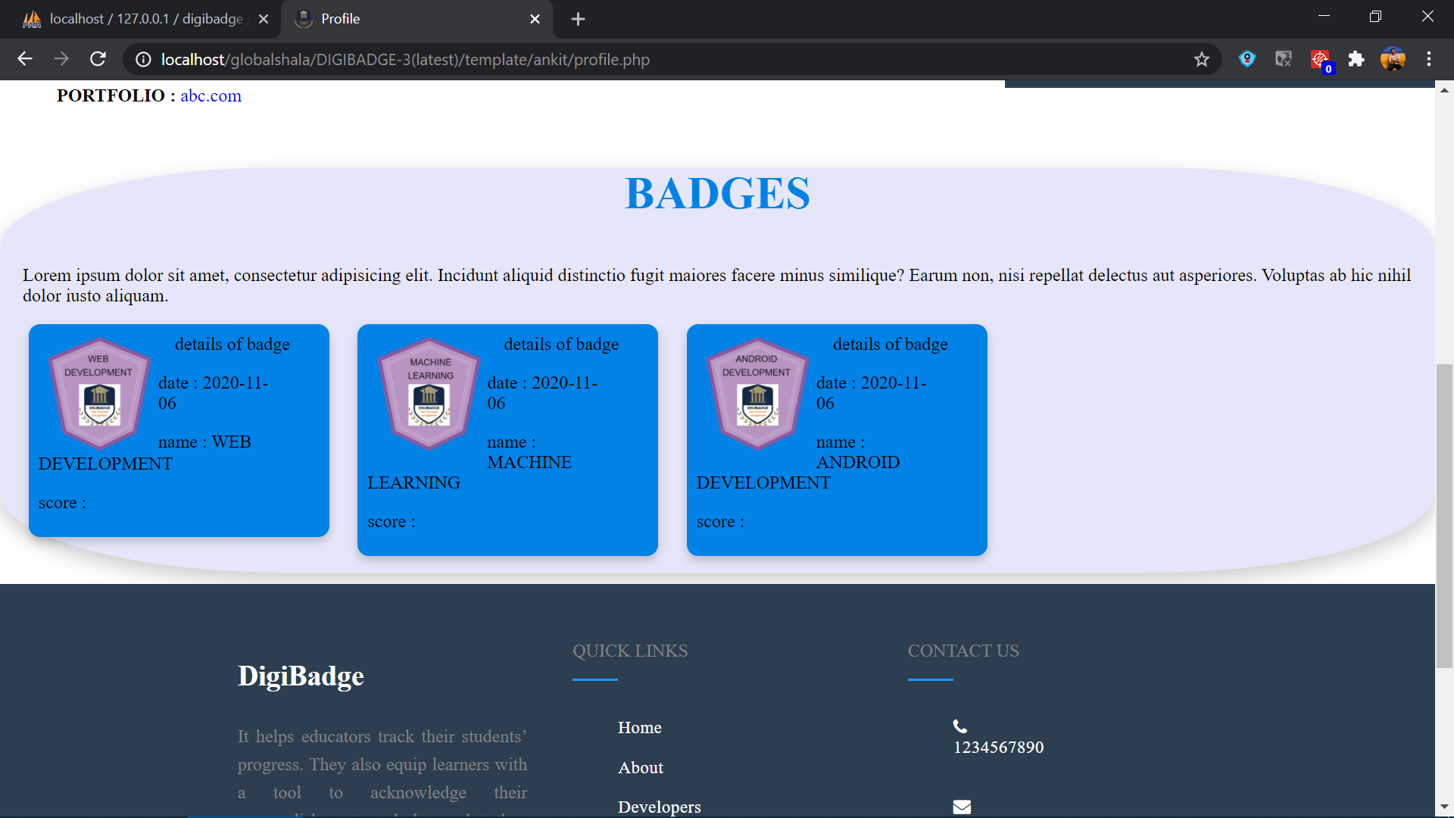
PROFILE PAGE - (BADGES)
The second scrolling page of the user profile page give us the info about how active he is i.e., number of new technologies the user learns in a given frame of time in a pie chart representation.

Slide 11
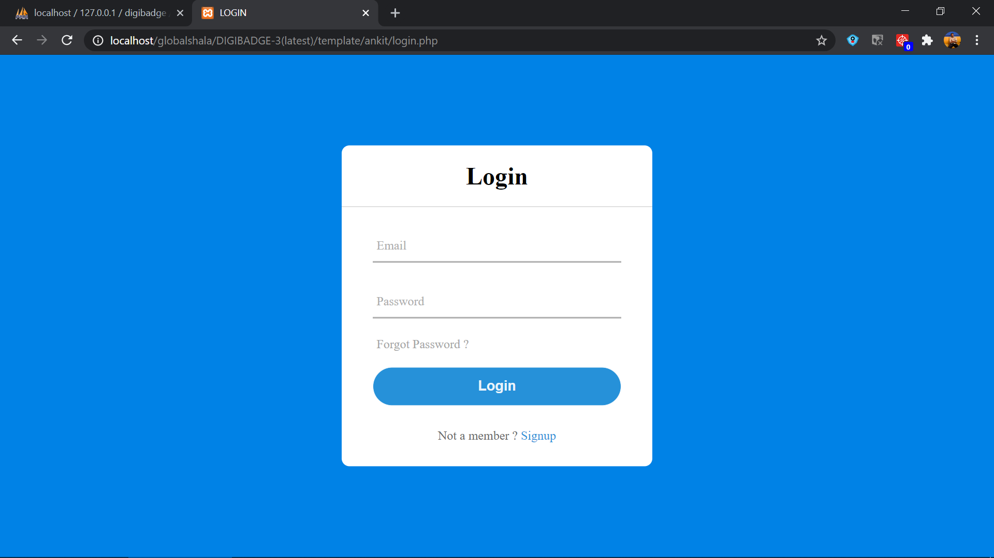
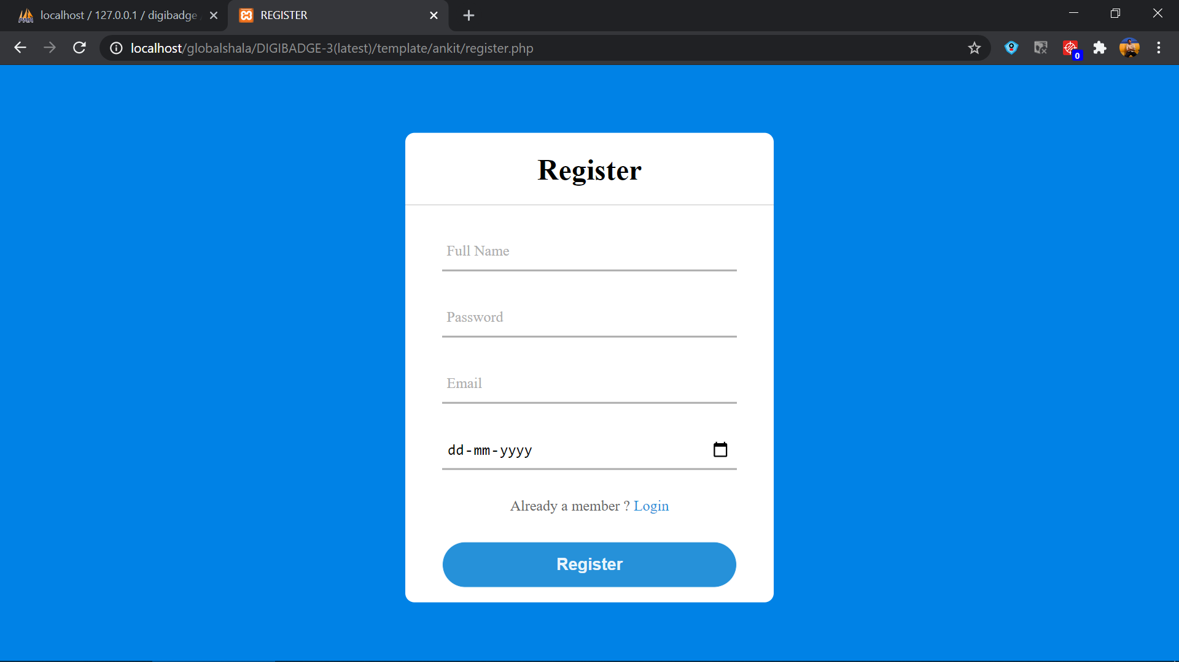
SIGN-UP / SIGN-IN PAGE
This is the prototype of the sign-up and sign-in page of the DIGIBADGE

Slide 12
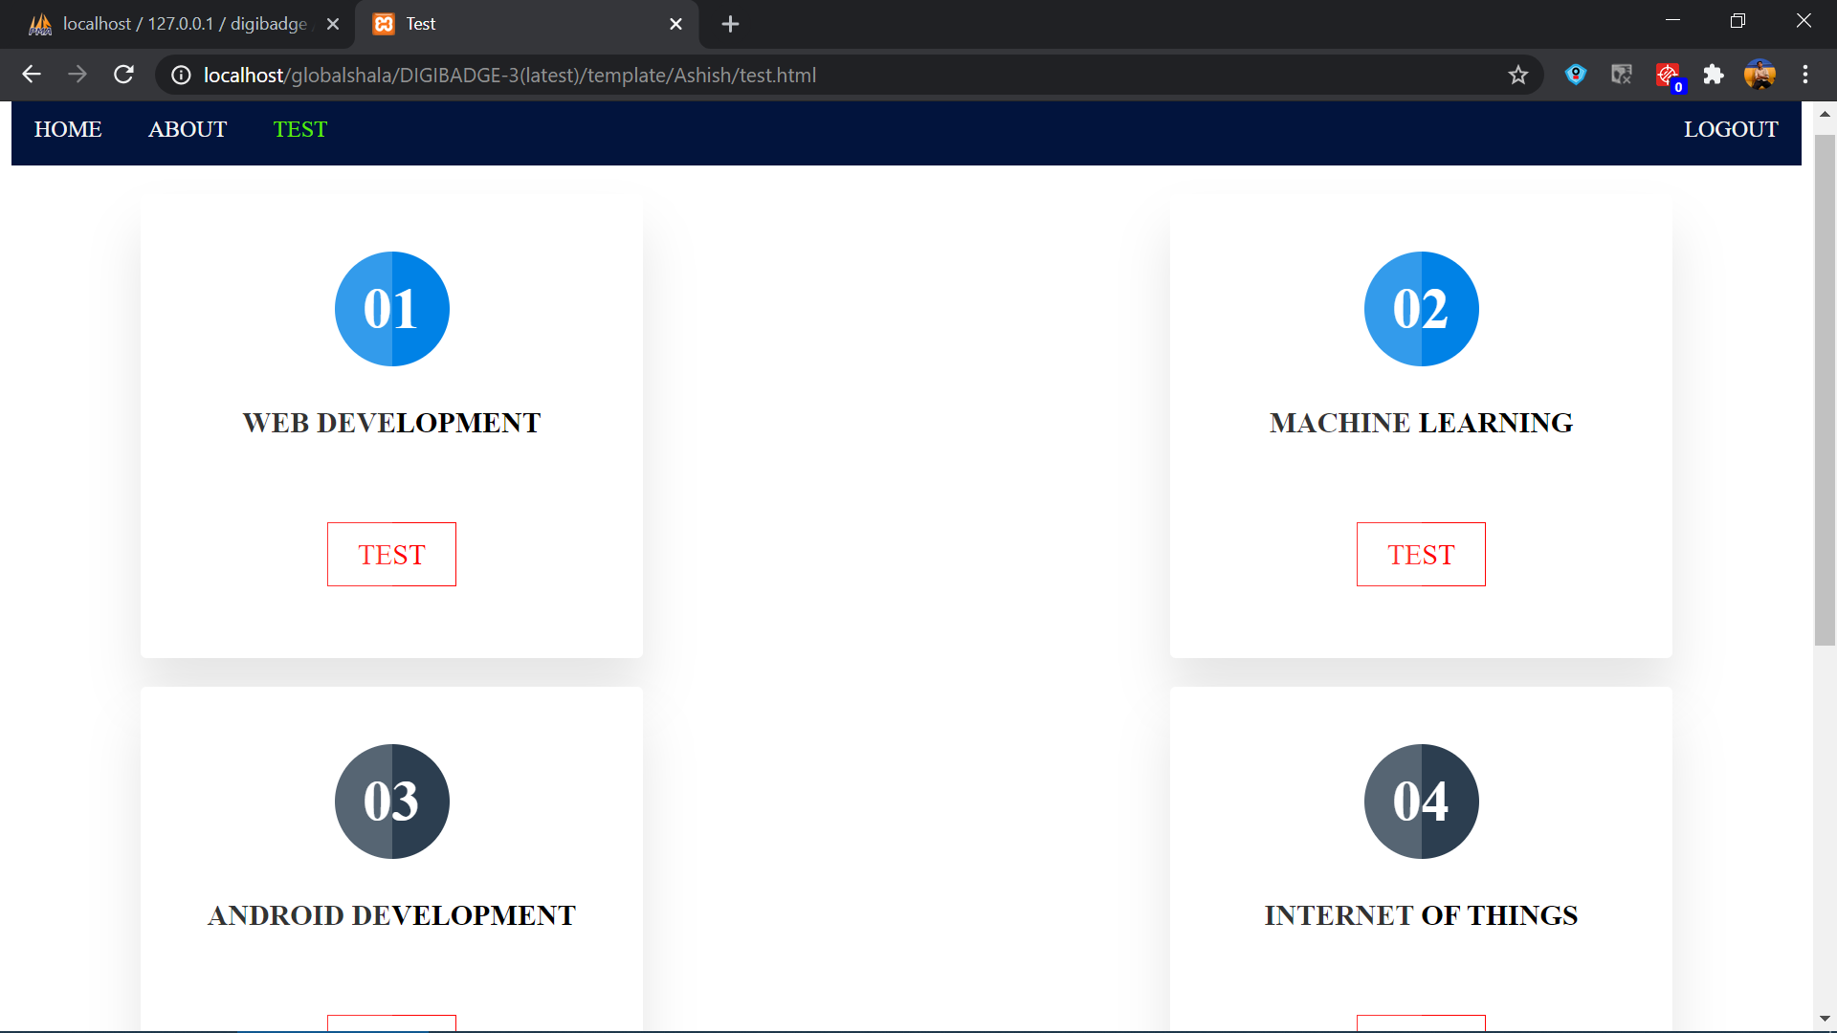
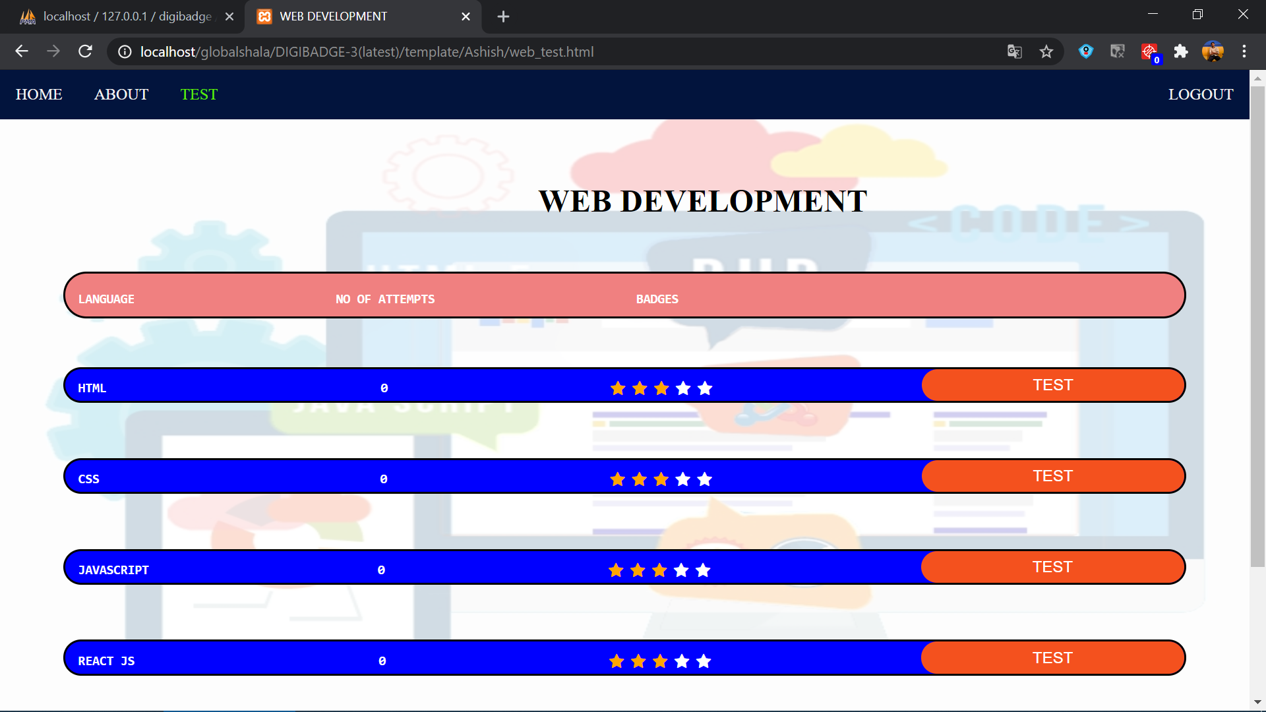
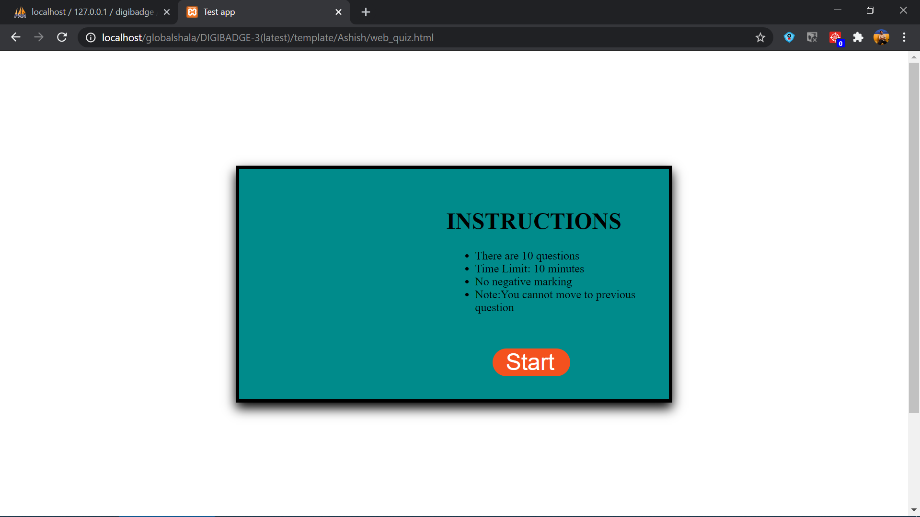
TEST PAGE
This the first page of test section which contains
all different fields in which test can be taken.It
also contains the highest badge (top right side)
which user has obtained in the given field.

Slide 13
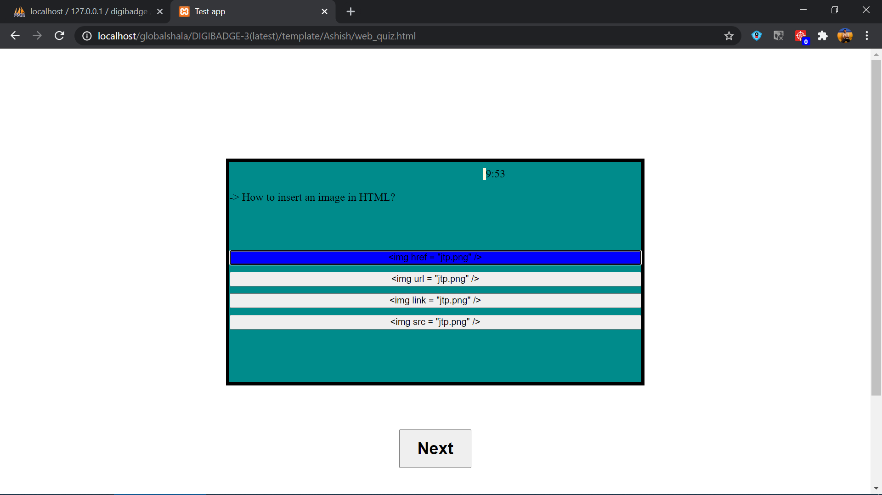
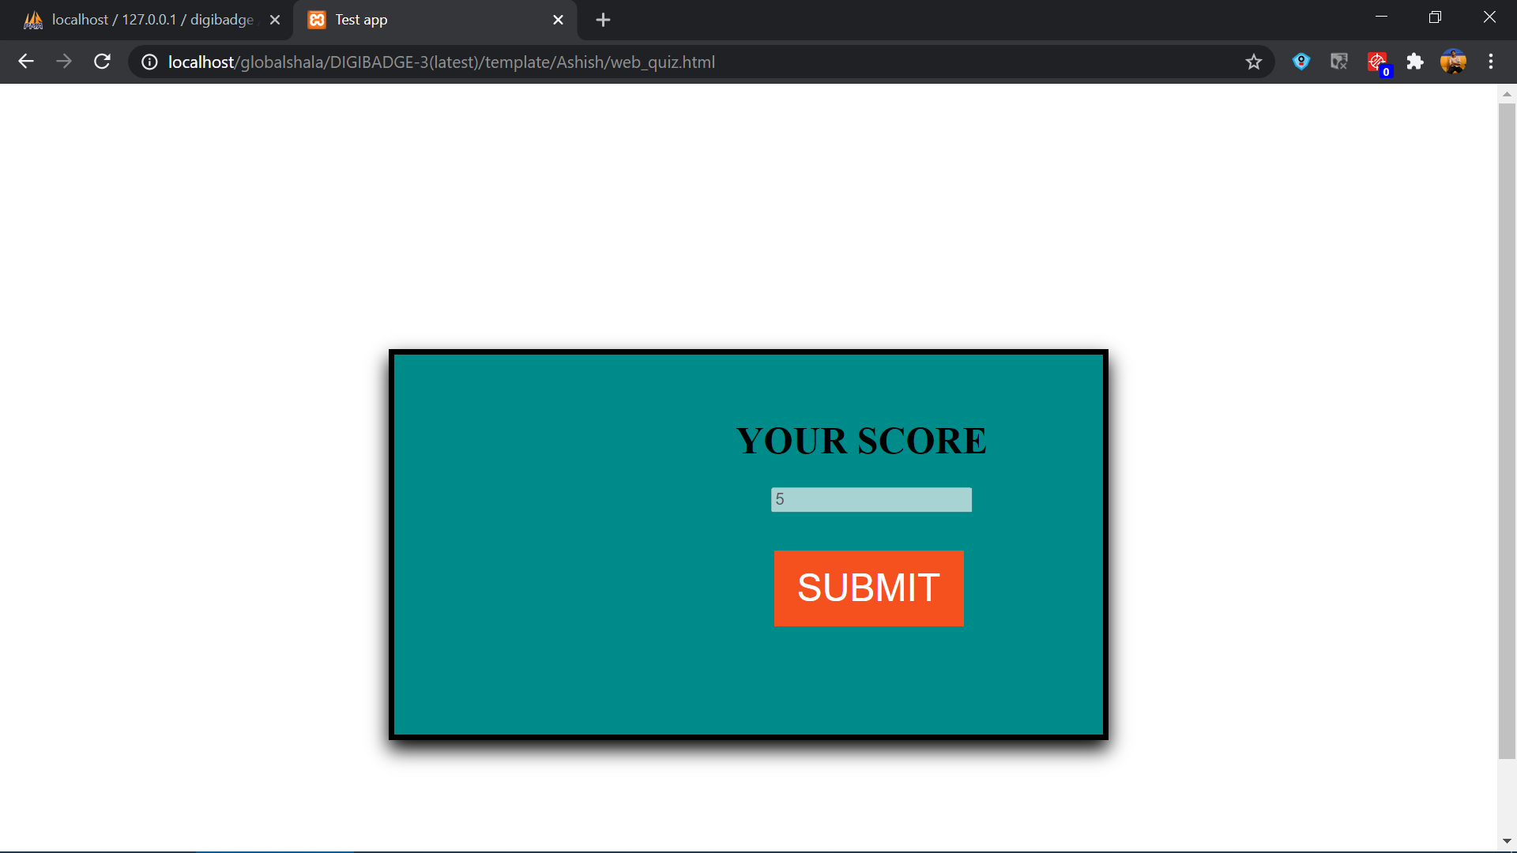
MCQ TEST PAGE
This the part of test page which contains the language
,framework in which the test for particular domain
can be taken.It also contains the no of attempts and
badges taken for particular language ,framework.
(The following slides will show how the subsection are
to be made for other domains).

Slide 14
FUTURE SCOPE
An automation can be later implemented for authenticity of the skills and certificates added by user.
Link sharing options can be added later so that user can share their badges in their social profiles.
Websitev can be made asynchronous using AJAX and JQUERY
Skill identificationcan be later added to recognise skills from the CV/Resume uploaded.

Slide 15
THANK YOU

